Slide 1

LO4 Fault Finding & Fault Analysis
Presenter name

Slide 2


Agenda
- This is a *template* for your evidence and analysis
- Leave no slide blank: write something (even if brief)
- Keep claims measurable: voltages, currents, timings, logs, screenshots

Slide 3

System Overview
- System purpose: [What job does it do?]
- Main subsystems: [Power] / [Control] / [Sensors] / [Actuators] / [Mechanical]
- Users/stakeholders: [Operator/technician/student]
Constraints: [Tools available, time, access limits]
THE ROBOTIC ARM

Slide 4

Normal Operation
- Start-up sequence: [Step-by-step, 3–6 steps]
- Normal behaviour: [Key states/modes]
- Shutdown behaviour: [How it stops safely]
[HINT]
- Include at least one *measurable* expected value (e.g., "5 V rail within 4.85–5.15 V" / "servo reaches 90° ±5°")

Slide 5
Chart if needed

Slide 6
Table if Needed
 | Category 1 | Category 2 | Category 3 | Category 4
Item 1 | 4.5 | 2.3 | 1.7 | 5.0
Item 2 | 3.2 | 5.1 | 4.4 | 3.0
Item 3 | 2.1 | 1.7 | 2.5 | 2.8
Item 4 | 4.5 | 2.2 | 1.7 | 7.0

Slide 7
Acceptance Criteria
- Performance criteria: [speed/position/temperature/pressure/etc.]
- Electrical criteria: [rails, current draw, noise, brownouts]
- Software/logic criteria: [state transitions, alarms, error handling]
- Safety criteria: [E-stop, interlocks, limits]
[PLACEHOLDER: list 4–8 pass/fail checks you will use later]

Slide 8
Table if Needed
 | Category 1 | Category 2 | Category 3 | Category 4
Item 1 | 4.5 | 2.3 | 1.7 | 5.0
Item 2 | 3.2 | 5.1 | 4.4 | 3.0
Item 3 | 2.1 | 1.7 | 2.5 | 2.8
Item 4 | 4.5 | 2.2 | 1.7 | 7.0

Slide 9

Quote Holder -HIDDEN SLIDE-
Author Holder

Slide 10
List Images Caption
Name Title
Name Title
Name Title
Name Title

Slide 11
Process
Title1
To start a presentation, go to the Slide Show tab, and select From Beginning.
Title2
To display Presenter view, in Slide Show view, on the control bar at the bottom left select the three dots, and then Show Presenter View.
Title
During your presentation, the speaker notes are visible on your monitor, but aren't visible to the audience.
Title
Title
The Notes pane is a box that appears below each slide. Tap it to add notes.
If you don’t see the Notes pane or it is completely minimized, click Notes on the task bar across the bottom of the PowerPoint window.

Slide 12
Safety & Risk Controls
Subtitle
Subtitle
- Key hazards: [moving parts / pinch points / stored energy / hot surfaces / electrical]
- Controls used: [isolation, PPE, guarding, safe workspace, one-hand rule, etc.]
- What you did *before measuring*: [inspection, power-down, discharge, permissions]
[PLACEHOLDER: short risk table in PowerPoint later]

Slide 13
Fault 1: Symptom Description
Fault label
Observable symptoms
When it happens
Add text, images, art, and videos.
Add transitions, animations, and motion.
Save to OneDrive, to get to your presentations from your computer, tablet, or phone.
Open the Design Ideas pane for instant slide makeovers.
When we have design ideas, we’ll show them to you right there.
This PowerPoint theme uses its own unique set of colors, fonts, and effects to create the overall look and feel of these slides.
PowerPoint has tons of themes to give your presentation just the right personality.

Slide 14
Fault 1: Fault-Finding Plan
Hypothesis list
Planned test order
- H1: [power issue]
- H2: [sensor issue]
- H3: [actuator/mechanics issue]
- H4: [software/logic issue]
1. [quick non-invasive checks]
2. [power checks]
3. [I/O checks]
4. [component swap / substitution if allowed]

Slide 15
Fault 1: Test Equipment
Name Title
Name Title
Name Title
Name Title

Slide 16
Fault 1: Test Equipment
For each item you used, fill:
- Instrument: [multimeter / scope / power supply / laptop logs / pressure gauge]
- Why used: [what question it answers]
- Settings/range: [VDC range, continuity mode, sampling, etc.]
- Safety notes: [probe placement, isolation, current limits]
- Limitations: [accuracy, loading, bandwidth, user error risks]

Slide 17
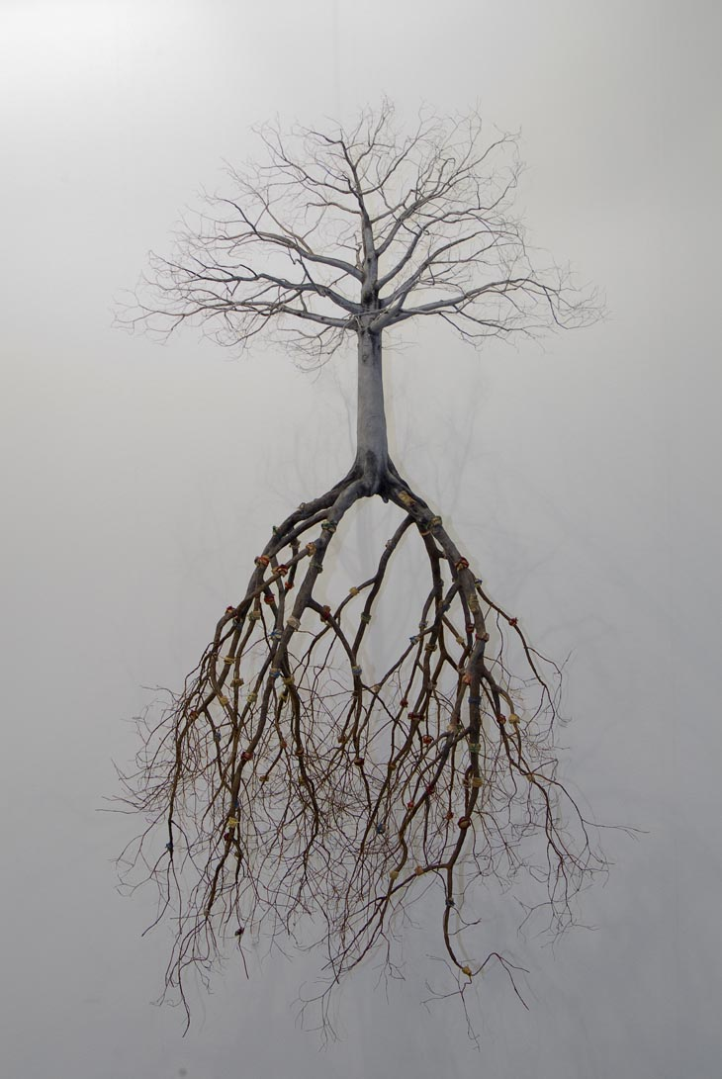

Fault 1: Root Cause + Rectification
- Confirmed fault location: [component/connection/code section]
- Root cause mechanism: [why it failed, not just what failed]
- Fix applied: [repair/replace/reseat/reprogram]
- Verification (retest vs acceptance criteria): [pass/fail + evidence]
- Return-to-service checks: [final safety checks]
This Photo by Unknown Author is licensed under CC BY-SA-NC

Slide 18
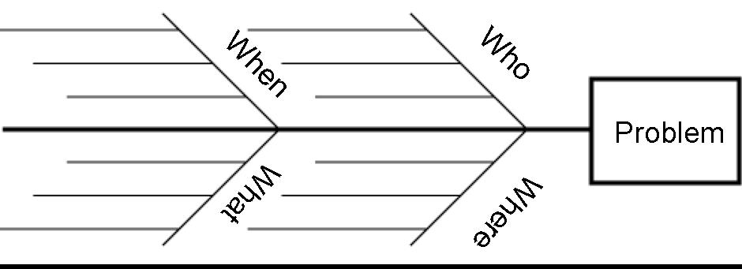
Fishbone Diagram (Optional)
https://www.learnleansigma.com/guides/fishbone-diagram/
https://www.youtube.com/watch?v=mLvizyDFLQ4&pp=ygUeaG93IHRvIG1ha2UgYSBmaXNoYm9uZSBkaWFncmFt

Slide 19

Reliability Improvements
- What made the fault likely? [design choice, environment, tolerance, user steps]
- Proposed amendments (choose 2–5):
- Hardware: [fuse, strain relief, connectors, filtering, shielding]
- Software: [timeouts, debouncing, sanity checks, logging]
- Process: [checklists, calibration schedule, inspection points]
- Trade-offs: [cost, complexity, performance impact]

Slide 20
Fault 1: Test Equipment
For each item you used, fill:
- Instrument: [multimeter / scope / power supply / laptop logs / pressure gauge]
- Why used: [what question it answers]
- Settings/range: [VDC range, continuity mode, sampling, etc.]
- Safety notes: [probe placement, isolation, current limits]
- Limitations: [accuracy, loading, bandwidth, user error risks]

Slide 21




Conclusion
What fault(s) were found and fixed? [1–3 bullets]
- What evidence proves the fix? [tests tied to acceptance criteria]
- What would you do next with more time? [further tests, redesign, monitoring]

Slide 22
References
Harvard Format

